Slide 1







Data Visualization NASA Astronauts 1959-2013
Edgardo Panza
Lucas Whitmire
Federico Rueda Luna
Master of Data Science – SoSe 2020

Slide 2
Agenda
Introduction to Dataset
First Look at Data
How to Become an Astronaut
How has the Path to Becoming an Astronaut Changed Over Time
Conclusions
2
Notes:
Total time: 20 mins.
Erase the time in each bullet point

Slide 3
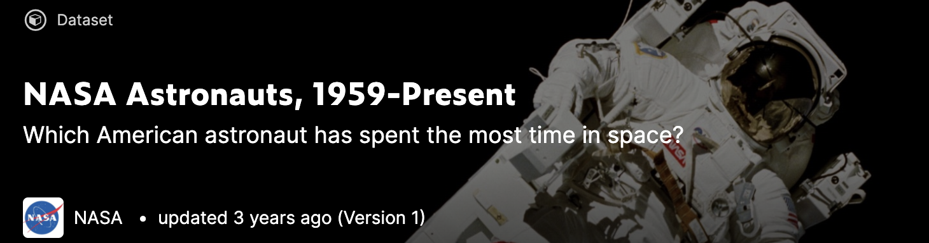
Introduction to Dataset
Information about 54 years of NASA Astronauts (1959-2013)
Gender, Induction Year, Education, Military Service, Missions, Time in Space, Time in Spacewalk
357 Astronauts
Questions to be answered:
Historically, what’s the path to becoming an Astronaut?
How has this path changed over time?
3

Slide 4
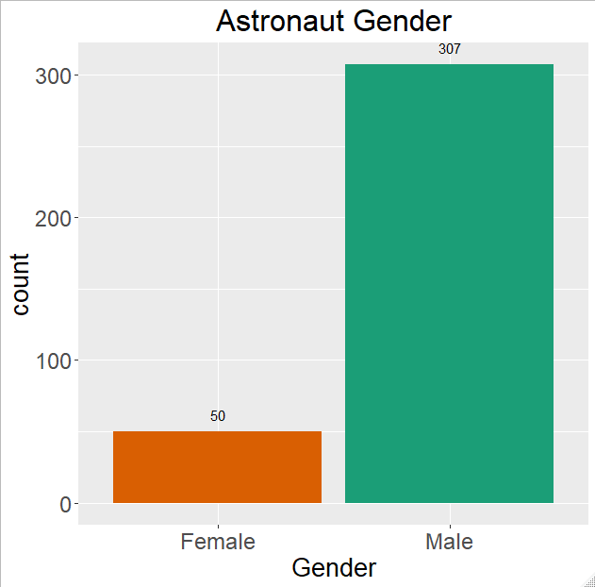
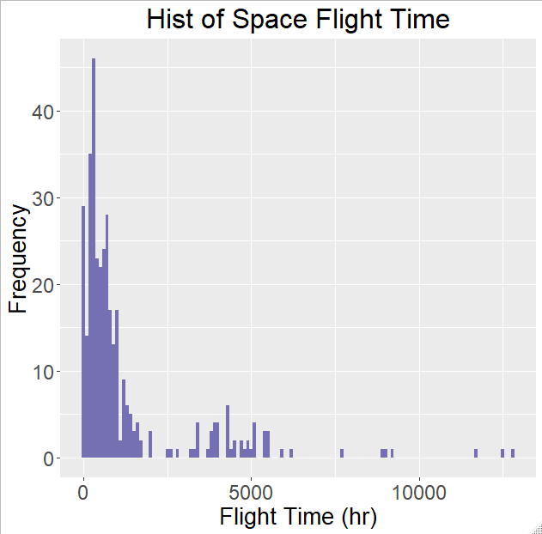
First Look at Data
Categorical Attributes:
Undergraduate Major: 87 unique entries
Graduate Major: 143 unique entries
Birthplace: 272 unique entries
4
Notes:
4

Slide 5
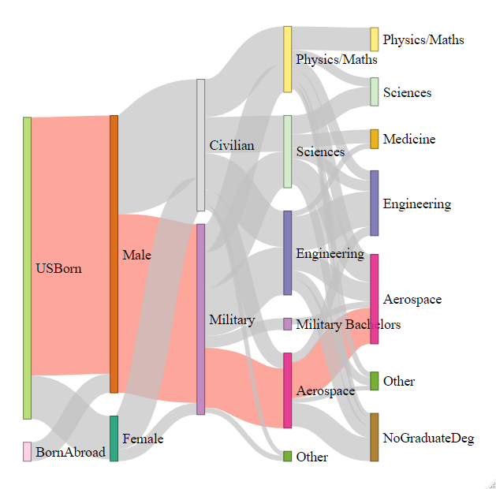
How to become an Astronaut?
5
Notes:
Path of least resistance presented in red.
Significant data cleaning was required for both Undergrad and Grad degrees (83 Under, 143 Grad)
Talk about breakout of aerospace from engineering/sciences/physics.
Links with values < 4 were removed for clarity.
5

Slide 6
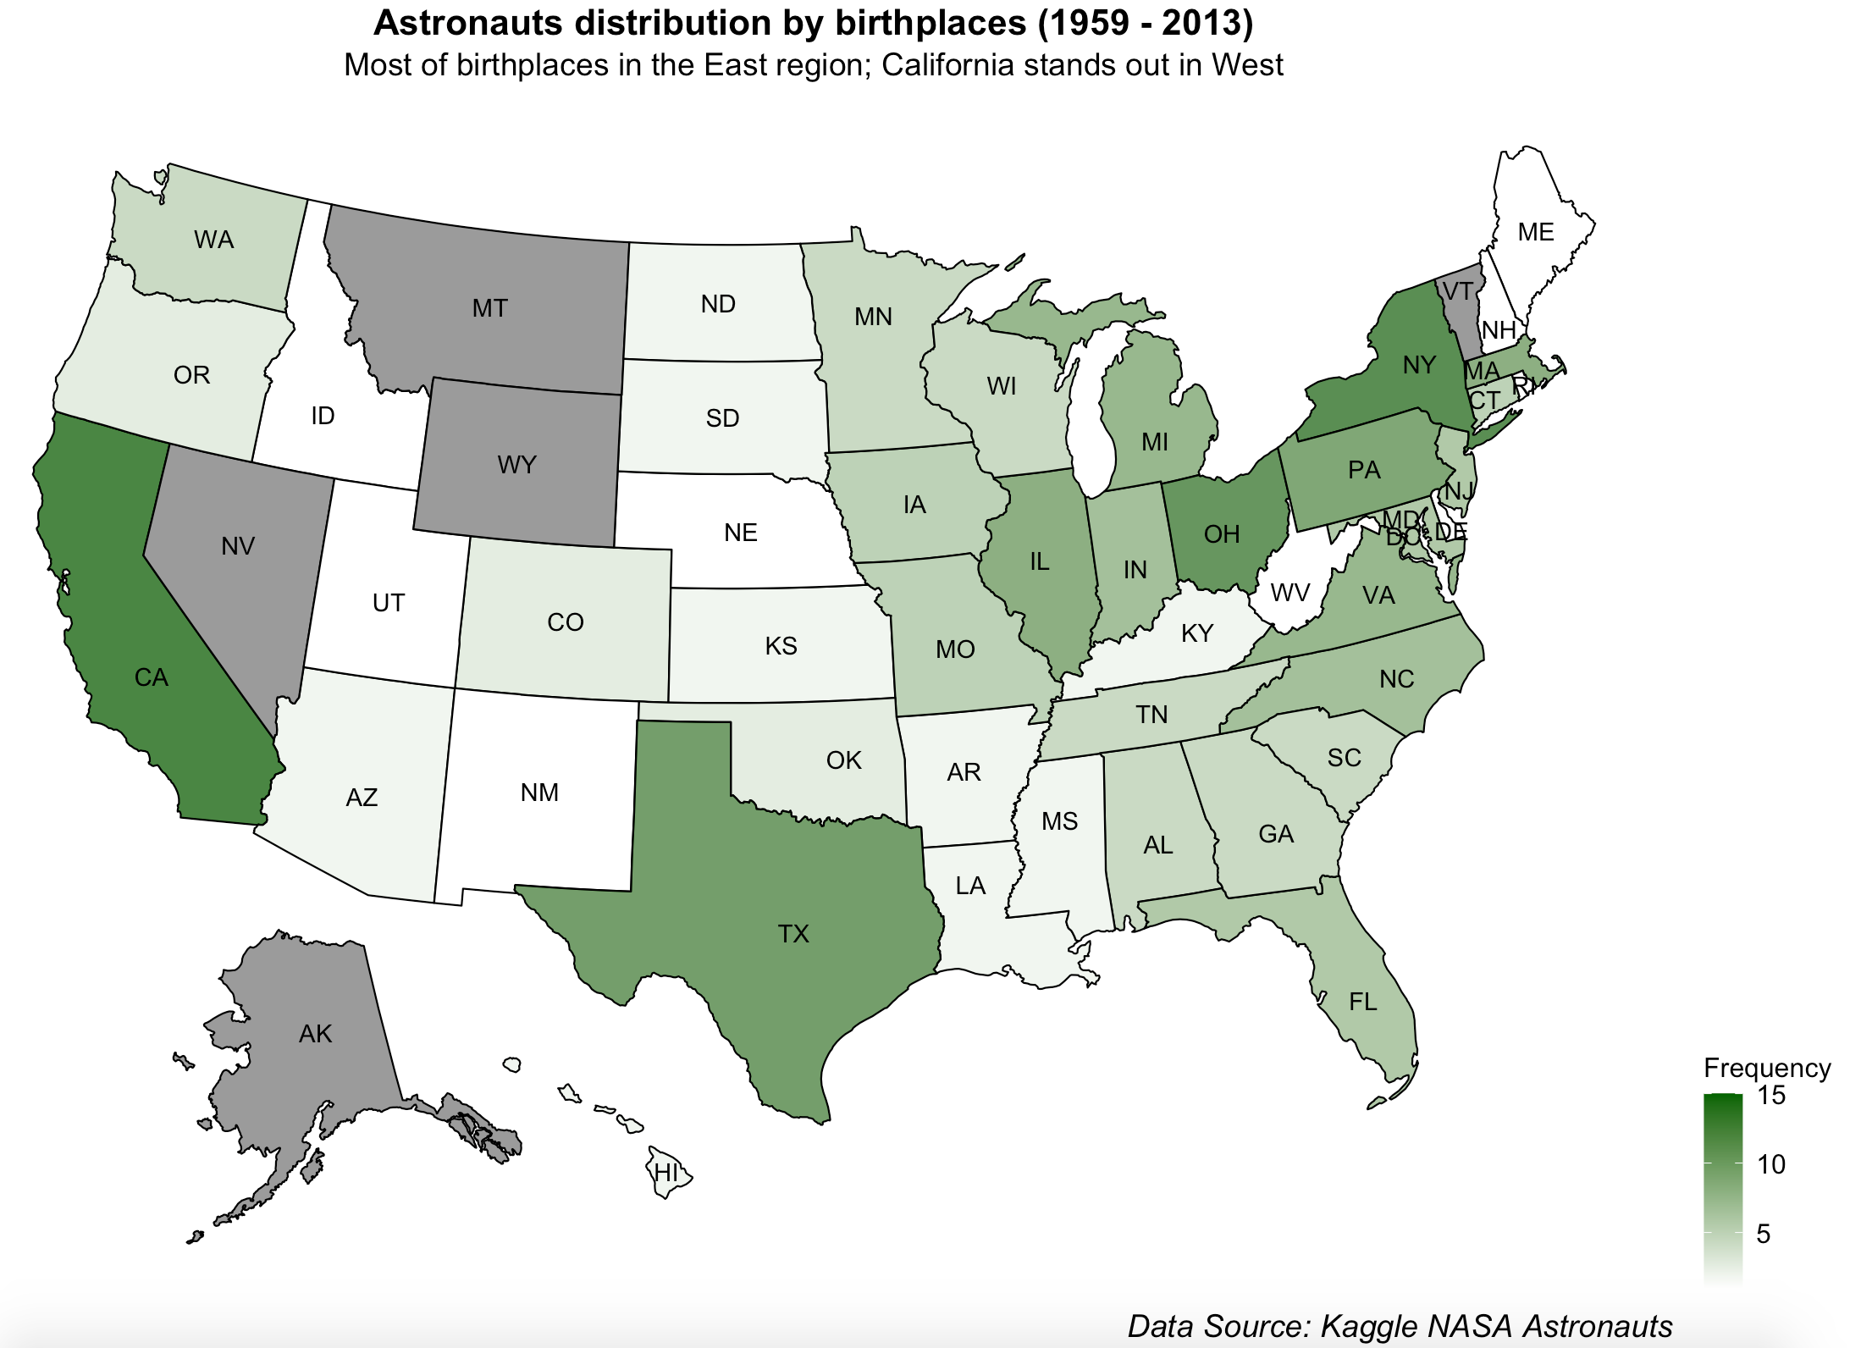
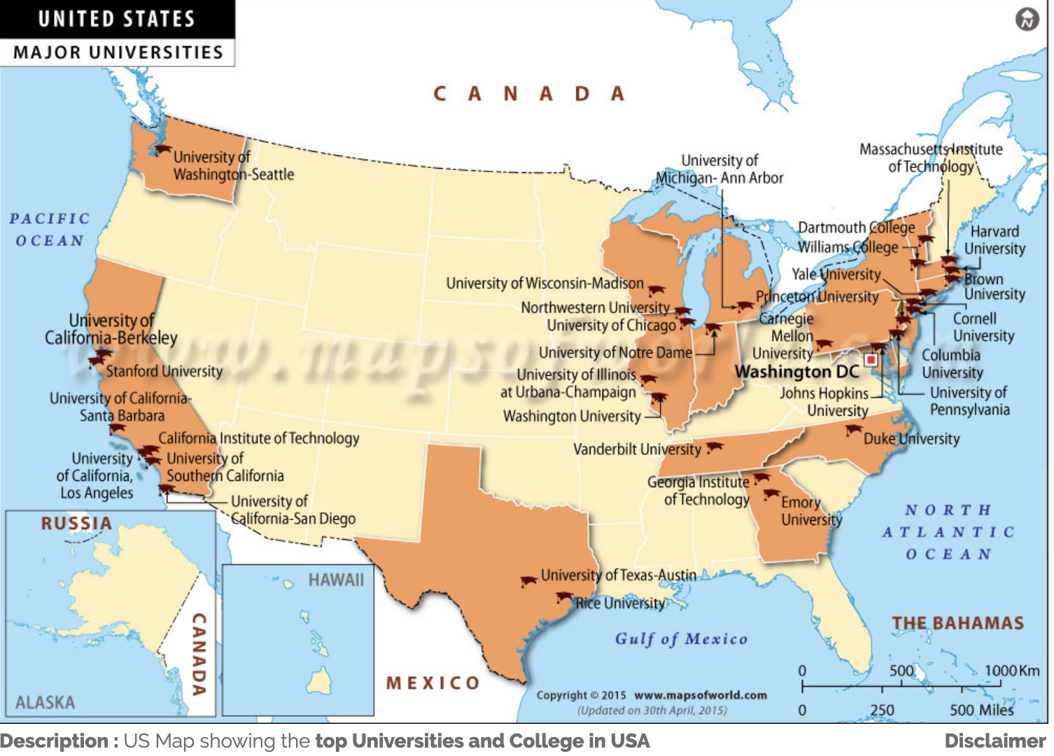

Exploration of paths to become astronauts - Birthplaces
6

Slide 7
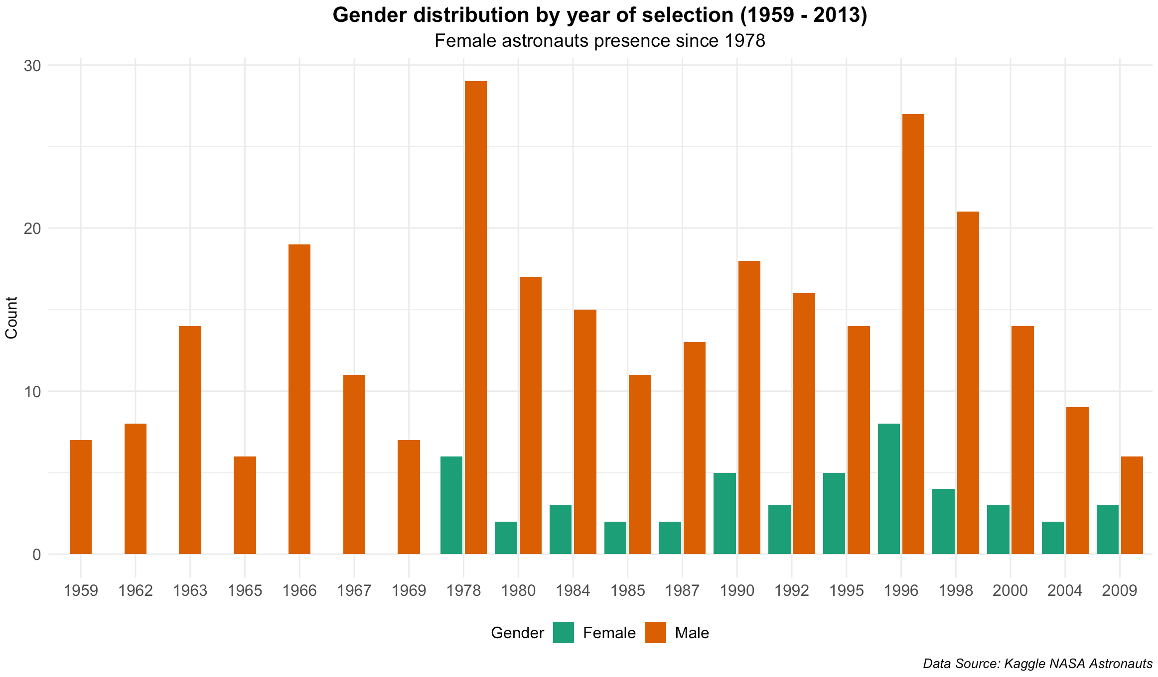
Exploration of paths to become astronauts – Gender Split
7

Slide 8
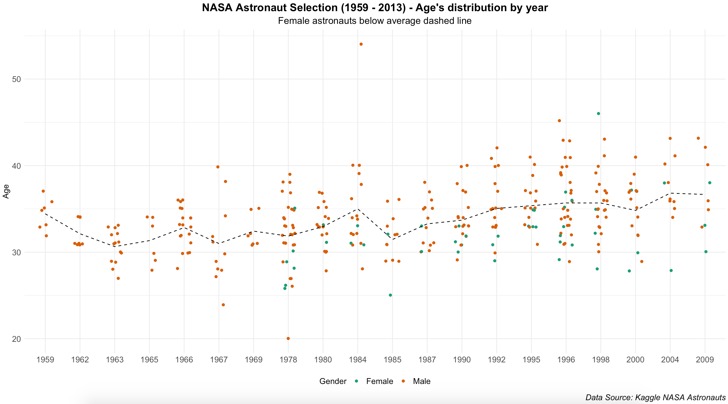
Exploration of paths to become astronauts – Gender Split
8

Slide 9
Ed – The challenges to become an astronaut
Sankey plot: what are the clear paths in order to become an astronaut…
9

Slide 10
Ed 2 – The challenges to become an astronaut
Sankey plot: what are the clear paths in order to become an astronaut…
10

Slide 11
QUESTIONS?
THANKS!
11
Notes:
11

